Slide 1

Data Security

Slide 2
Cryptography
Integrity
Confidentiality
Authenticity
Non-Repudiation

Slide 3

Encryption
Encryption is the process of scrambling or enciphering data so it can be read only by someone with the means to return it to its original state

Slide 4
Types of Cryptography
Symmetric Key
Stream Ciphers
Block Ciphers
Asymmetric Key

Slide 5
Symmetric Encryption
From: Computer Security Principles & Practice (3rd Edition)

Slide 6
Symmetric Encryption Algorithms
From: Computer Security Principles & Practice (3rd Edition)

Slide 7
Encryption with Public Key
From: Computer Security Principles & Practice (3rd Edition)

Slide 8
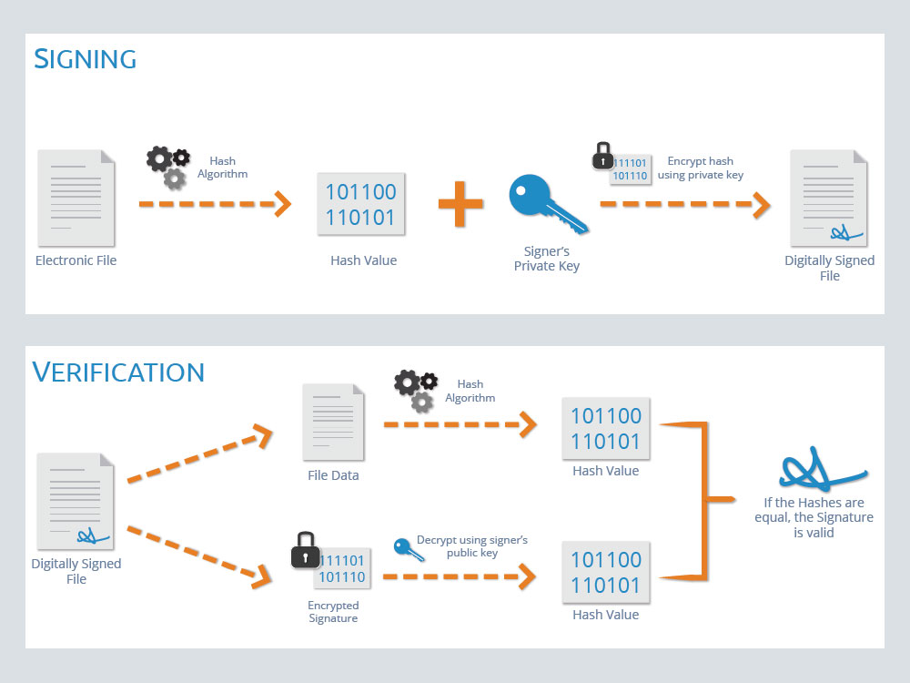
Digital Signature

Slide 9
Public Key Certificates
From: Computer Security Principles & Practice (3rd Edition)

Slide 10
HSM
Hardware Security Modules
Designed to store secret keys safely
Tamper proof
Certified against International Standards, ex: FIPS 140
For Cloud based infrastructure, Cloud based HSM provide better speed

Slide 11
AWS CloudHSM
AWS CloudHSM is a cloud-based hardware security module (HSM) that enables you to easily generate and use your own encryption keys on the AWS Cloud.
With CloudHSM, you can manage your own encryption keys using FIPS 140-2 Level 3 validated HSMs.
CloudHSM offers you the flexibility to integrate with your applications using industry-standard APIs
It is a fully-managed service that automates time-consuming administrative tasks for you, such as hardware provisioning, software patching, high-availability, and backups

Slide 12
KMS
Key Management System
Create and Control Encryption Keys
These keys are used to encrypt our data
Integrated with other AWS Services
S3, EBS, RDS,RedShift etc

Slide 13
KMS Features
Create Master Keys
These cannot be exported out of the service
Encrypt, Decrypt, Re-Encrypt using Master Keys
Generate Data Encryption Keys
Both plain text and encrypted
Used to encrypt data

Slide 14
Terminology
Customer Master Key (CMK)
Can protect upto 4KB of data
CMK does not leave KMS unencrypted
Data Keys
Used to encrypt data
Plain text and encrypted data key
Plain text used to encrypt data. Encrypted data key stored with data

Slide 15
Envelope Encryption
Envelop Encryption used to protect data
Plain text is encrypted using unique data key
Data key is then encrypted and stored with data

Slide 16
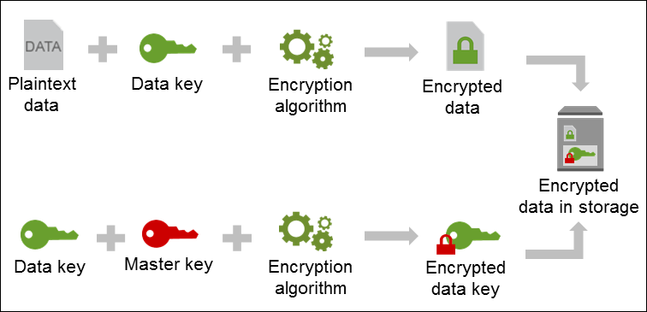
Envelope Encryption
Image Source: AWS Documentation

Slide 17
Encryption in S3
Server-Side Encryption (SSE)
SSE – S3
S3 Manages Data and Master keys
SSE – C
Customers manage their own keys
SSE – KMS
Keys managed by KMS
S3 Encryption Client
Encrypt in application and upload to S3

Slide 18
Other services that can use KMS
CloudTrail
EBS
DynamoDB
SQS
Glacier
Kinesis

Slide 19
KMS Key Rotation
Cryptographic best practices discourage extensive reuse of encryption keys
When you enable automatic key rotation for a KMS key, AWS KMS generates new cryptographic material for the KMS key every year
AWS KMS saves all previous versions of the cryptographic material in perpetuity so you can decrypt any data encrypted with that KMS key
AWS KMS does not delete any rotated key material until you delete the KMS key

Slide 20
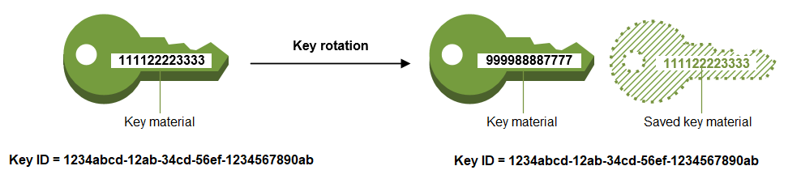
KMS Key Rotation
AWS KMS supports automatic key rotation only for symmetric KMS keys with key material that AWS KMS creates
Automatic rotation is optional for customer managed KMS keys
Key rotation changes only the KMS key's key material, which is the cryptographic material that is used in encryption operations
The KMS key is the same logical resource, regardless of whether or how many times its key material changes

Slide 21
Thanks

